Slide 1

Krisztian Stancz
https://github.com/skrisztian
Why to make it simple
if you can make it complex?
Green Fox Academy
Hardware Programming
26 May 2017

Slide 2
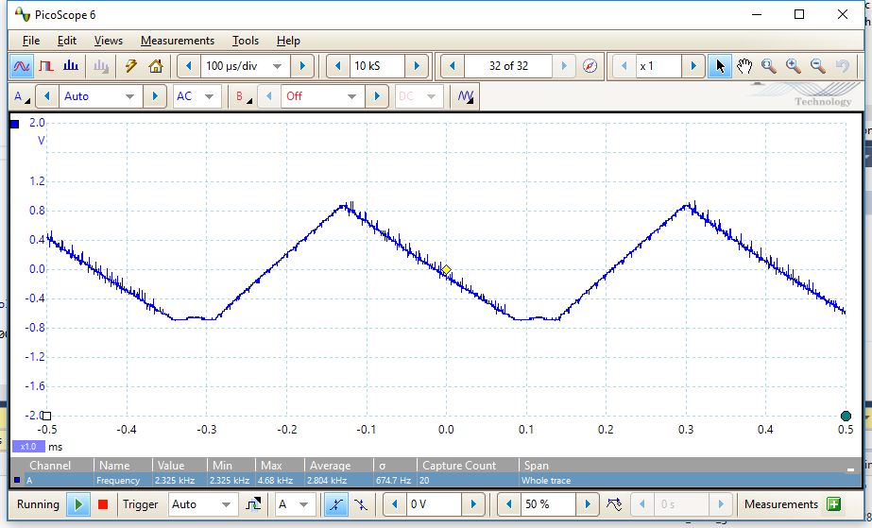
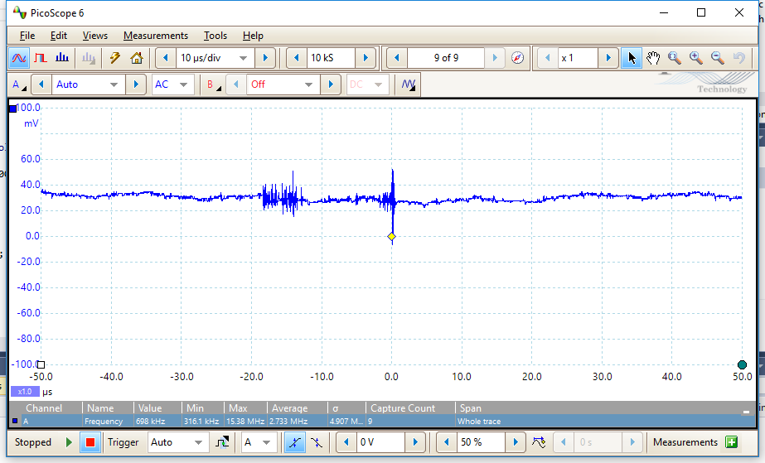
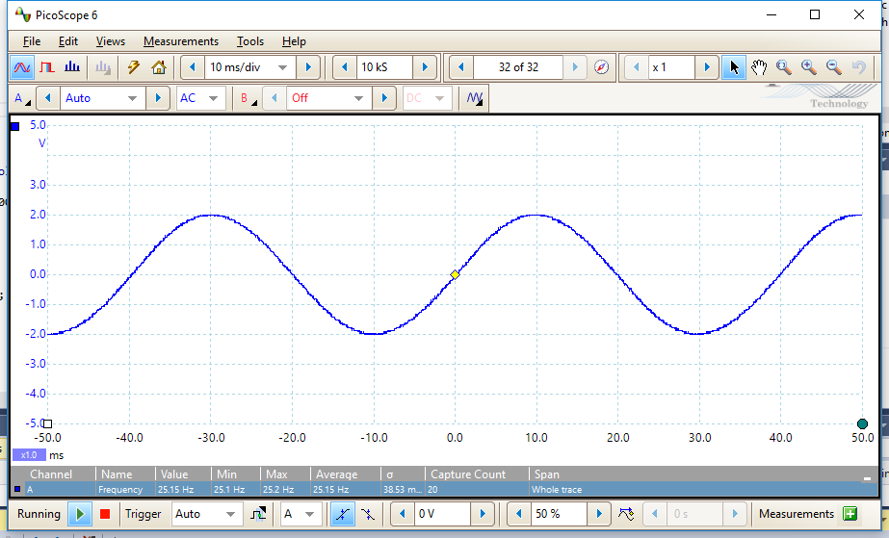
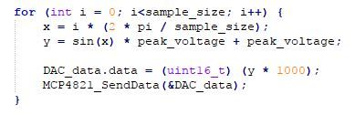
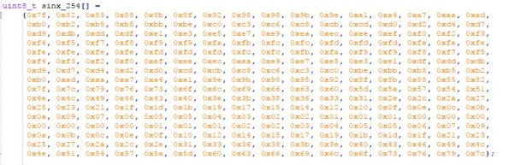

From last week's episode...
Sine wave generator on ATmega168PB
sample size: 3
frequency: 2300 Hz
sample size: 10000
frequency: -
sample size: 256
frequency: 25 Hz
sample size: 256
frequency: 416 Hz

Slide 3
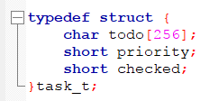

To-do
List (storage methods)
1.
2.
To-do:
“feed cat”
Priority: 1
Checked: 0
3.

Slide 4
Storage in array
Sane
way
data
Complexity: 1
“Clever”
way
pointer
Complexity: 2
data

Slide 5
Delete a to-do
Sane
way
X
copy
data
move
Complexity: 1
“Clever”
way
pointer
Complexity: 4
+ watch for deleted
+ cleanup routine
Flag as deleted
data

Slide 6

List to-dos
0
1
2
3
4
5
Sane
way
data
Complexity: 1
“Clever”
way
pointer
Complexity: 8
+ watch for deleted
+ cleanup routine
+ extra array for
listing
Flag as deleted
data
0
1
2
3

Slide 7

List to-dos by priority
0
1
2
3
4
5
Sane
way
data
Bubble sort
Complexity: 1
“Clever”
way
pointer
Complexity:
+ watch for deleted
+ cleanup routine
+ extra array for
listing
+ extra array for
sorted list
+ track which list
is used
Flag as deleted
data
0
1
2
3
Bubble sort
0
1
2
3

Slide 8

Delete a to-do
Sane
way
X
copy
data
move
Complexity: 1
“Not so
clever
anymore
but still”
way
pointer
X
copy
move
free()
Complexity: 2
data

Slide 9
Delete a to-do
Sane
way
X
copy
data
move
Complexity: 1
“Not so
clever
anymore
but still”
way
pointer
X
copy
move
free()
Complexity: 2
data

Slide 10
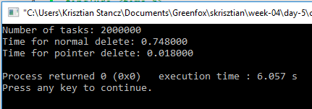
Delete one to-do
Sane
way
Complexity: 1
“Not so
clever
anymore
but still”
way
Up to 40x faster
Complexity: 2

